Slide 1
Research Enablement Initiative- Unburdening Researchers
Sherly Mosessian Ph.D
UCLA Health IT- DGIT
Acting CIO, CAO, Director of Research Enablement

Slide 2
Agenda
Overview of DGIT
Why Research Enablement?
Three Pillars:
Discovery
Engagement and Enablement
Communication and Training
Lessons learned
Challenges

Slide 3
What is DGIT:
ISS | OHIA | DGIT
UCLA Health Information Technology
DGIT is an information and digital technology organization serving the UCLA Health schools of Dentistry, Medicine, Nursing, and Public Health. DGIT is one arm of the UCLA Health IT organization, collaborating closely with hospital's information technology team, Information Services & Solutions (ISS) and Office of Health Informatics and Analytics (OHIA) to ensure delivery of high-quality services throughout UCLA Health Sciences.

Slide 4
DGIT’s org structure
DGSOM Dean Kelsey Martin M.D. Ph.D
UCLA Health Sciences CIO Michael Pfeffer M.D.
Acting Chief Information Officer, DGSOM Sherly Mosessian Ph.D
CAO & Director of Research Enablement Sherly Mosessian Ph.D
Sr. Director, IT Service Delivery Arun Budhwani
Director, IT Infrastructure
Mike Shane
Director,
Client Services
Scott Painter
Chief IT Security Officer Edgar Tijerino
Sr. Director of Enterprise Applications William Holloway
Director, Software Development Buddy Dennis Ph.D
Education Technology
Director, Network and Communications
Adrian Finemel
AudioVisual

Slide 5
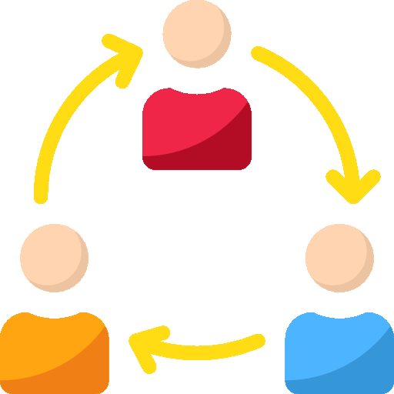
DGIT’s journey
UCLA Health Cybersecurity Breach
Launch of DGIT
Enhanced security through integration of IT across DGSOM
Initiate IT merger across Health Sciences Schools (Nursing, Dentistry and Public health
Launch of Research Enablement Initiative
2015
2016
2017
2018
2019

Slide 6
Accounts & Access
Network & Connectivity
Audio Visual (AV) Services
Productivity & Collaboration
Core Services
DGIT provides a dynamic portfolio of services and capabilities for faculty, students, and staff that support
Education
Research
Analytics
Web development
Administrative functions
The technology solutions we deliver fulfill DGIT’s standards for security, reliability, scalability, accessibility, and innovation. They are intended to accelerate the university’s academic and research endeavors.
Device & User Support
Research Enablement
Educational Technology
Software Development
Enterprise Data
Storage & Servers
Information Security

Slide 7
Researcher profile
What is the primary source of funding for research faculty?
State funding b) Gifts c) Grants d) UC Regents
Is the purchase of computers allowed on most grants?
Yes b) No
On average, what is the timeline from grant preparation, submission to award?
3 months b) 5 months c) 9 months d) 12 months
On average, what percent of grants get funded?
5% b) 14% c) 30% d) 50%
What is the average direct payout of a research grant in a year?
50K b) 100K c) 200K d) 500K
What is the average annual cost of running an academic laboratory?
a) 100K b) 250K c) 450K d) 900K

Slide 8
Researcher Feedback
No official onboarding process with faculty joining UCLA to address technology needs.
DGIT support staff do not provide holistic solutions on devices connected to laboratory solutions.
New security software installs or patches disrupt research tied to laboratory devices/instruments.
Minimum direct communication and feedback mechanism with the research community.
No regular meetings between Department Chairs and DGIT.
Cybersecurity solutions to laboratory devices are disruptive and or costly.

Slide 9
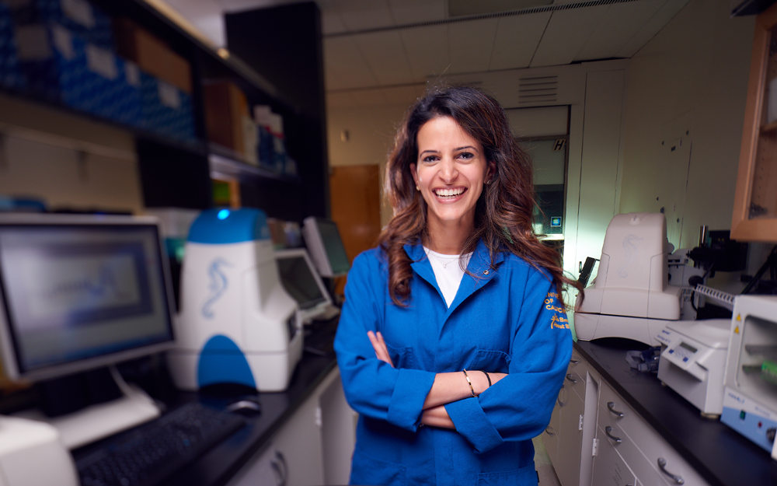
Research Enablement Program
Discovery
Laboratory inventory
Establish a balanced security and support model
Engagement and Enablement
Faculty onboarding
Governance structure
Targeted faculty interactions and meetings
Augment existing services/new initiatives
Communication + Training
Highlight successful collaborations with researchers
Website and marketing
Technology event launches and training efforts
Photo credit | Khris Griffis

Slide 10
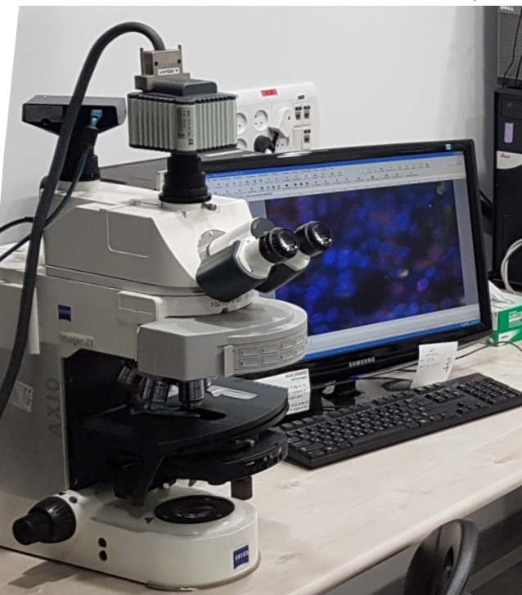
Discovery

Slide 11
Laboratory Device Inventory Project for School of Medicine
Started August 2018 - Completed January 2019
Project goal:
Inventory of research laboratory devices with emphasis on devices supporting laboratory instruments.
Understand research laboratory environments and types of devices requiring support.
Create a process for devices connected to instruments to go through an exception process to ensure patches and other security policies do not negatively impact them.

Slide 12
Laboratory Device Inventory Project for School of Medicine
81% Achieved (380 laboratories out of 471 inventoried)
Collect/Validate Computer Assets In DGIT Laboratory Spaces
285 “Instrument” Devices Documented
1276 “Desktop/Laptop” Devices Updated / Created New
Average research devices per lab - 3
Not connected to network - 68% (192)
DGIT SOPs Updated
Desktop Support Policies
Asset Deployment
Software Management
Security Exceptions

Slide 13
Lessons Learned
Next steps
Majority of laboratory devices are not supported by IT
Due to funding restrictions faculty have old devices/software tied to critical laboratory equipment
To avoid network security concerns, faculty have placed majority of the devices off network (68%)
Researchers are concerned about engaging IT and being tied down with strict security requirements; instead find their own solutions
Updated the desktop device intake process to handle lab/medical devices requiring special controls
Identify flexible network and security solutions for researchers- Security and support playing the role of partners
Use the lab inventory as a launching pad to start faculty engagements and forming custom solutions

Slide 14
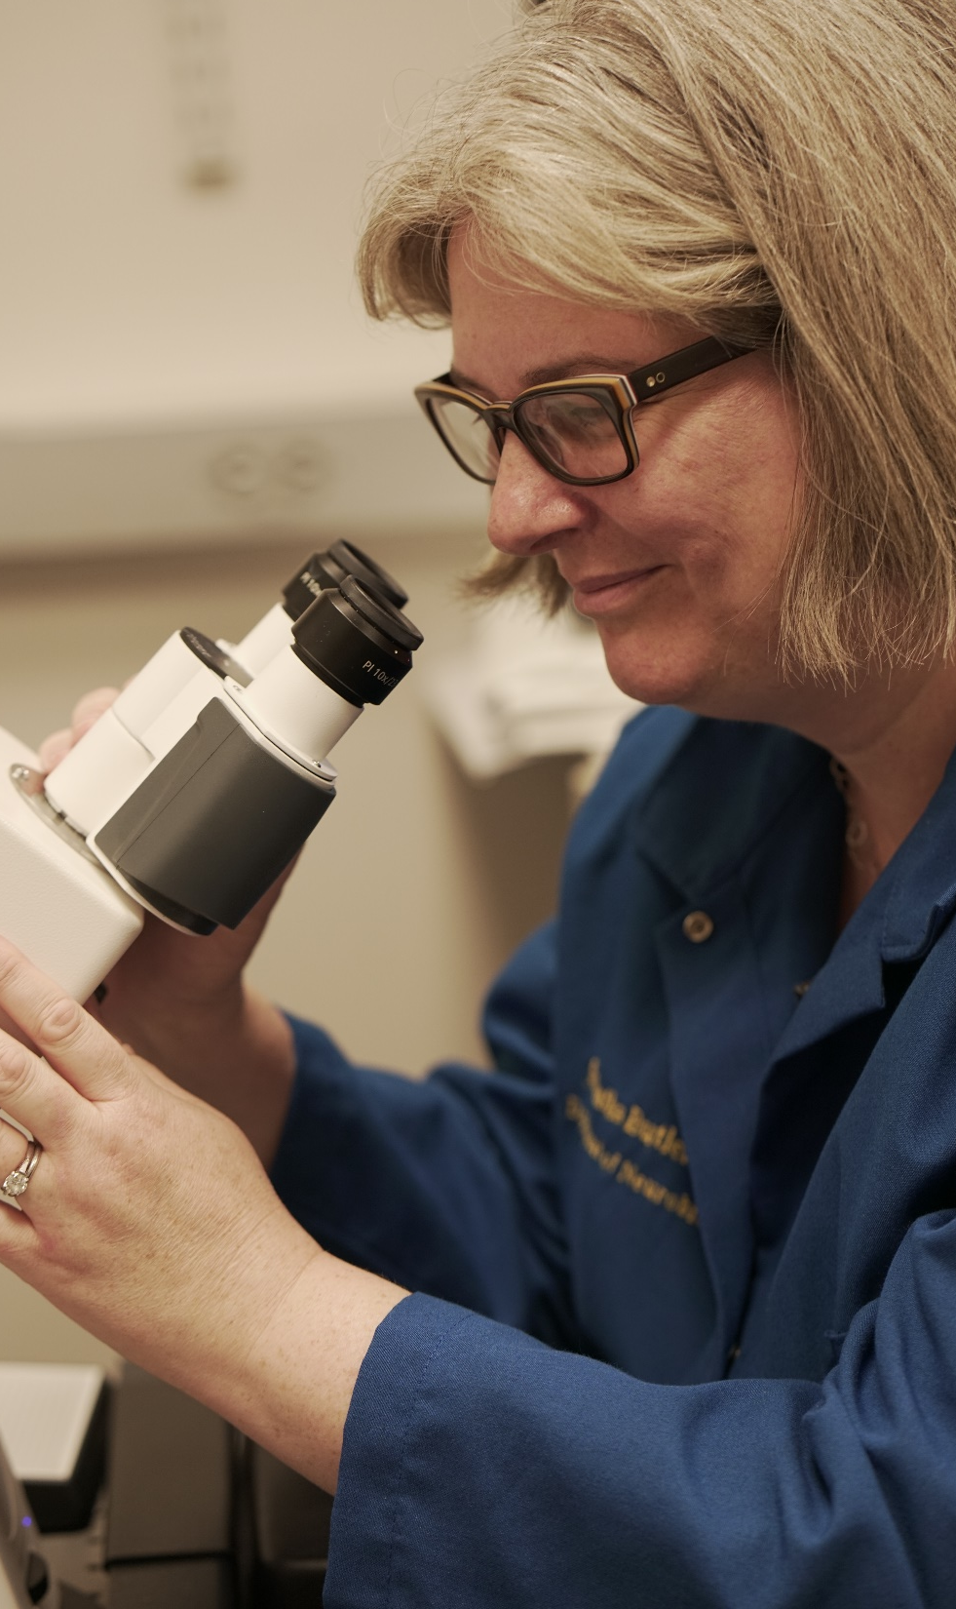
Engagements & Enablement
Research IT Governance
Faculty Engagements
Augmented services and offerings

Slide 15
DGIT IT Governance Overview
IT Steering Committee
Chair- Dr. Steinberg
Health Sciences Schools IT Prioritization Committee
Chair- Dean Kelsey Martin
Research Enablement Advisory Group
Chair- Dr. Smale, Vice Dean of Research
Education Technology Advisory Group
Chair- Dr. Braddock
Service Delivery Advisory Group
Chair- Dr. Aparna Sridbar
Membership Across Health Sciences Schools

Slide 16
Research Enablement Advisory
Purpose
Provides governance of projects and initiatives to address the technology needs of the basic science research community.
Represent the basic science research community needs and perspectives of various constituents across the research mission of UCLA Health Sciences.
Establish policies, review and provide guidance on IT initiatives that impact the research community.
Assemble and charge focused working groups and subject matter experts which include appropriate stake-holder representation to evaluate existing efforts and propose new projects and initiatives.
Provides a forum for managing competing research interests and priorities.
Kicking Off
December 2018
Frequency: Monthly
5 meetings have been held

Slide 17
Advisory Efforts
Transparent review of IT research funding and major project prioritization
Establish Service Level Agreements and user cases for compute/storage offerings
Establish an IT resource document for Grants
Establish a one stop shop website for researchers
Optimize training for major tools- Specifically Box
Launch faculty onboarding

Slide 18
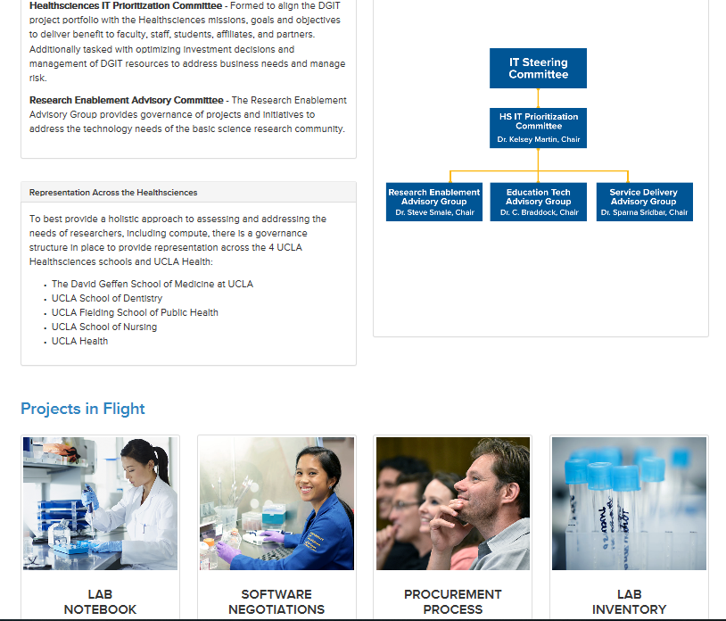
Research Enablement Website (DRAFT)

Slide 19
IT Resource Document for Grants Objective
To provide the Health Sciences research community with a complete list of DGIT resources that can be easily copied and pasted into grant applications. Our goal is to help reduce the amount of time and energy researchers spend locating and gathering this information. Also, add consistency in how IT resources are represented in grant documents

Slide 20
Approach and feedback
Interviewed stakeholders for information gathering and outreach recommendations.
Business
IT
Dion Baybridge
Sherly Mosessian
Stressed importance of communicating to faculty that service is now available.
Led project and connected team with stakeholders for interviews.
Emilie Marcus
Mike Shane
Recommended getting the word out to junior faculty and measuring effort’s success.
Provided information about DGIT’s servers and storage most relevant to researchers.
Robin Faria
Sheila Minton
Provided information about CTSI’s services and offered to leverage communication platforms.
Collaborated with DGIT to include information about OHIA’s services most relevant to researchers.
Jessica Castillo
Buddy Dennis
Offered to plug resource on CTSI’s website, newsletter, and digest as soon as it’s ready.
Shared experience with and samples of previous grant proposals.

Slide 21
Outcome
New Grant Information webpage with Word document

Slide 22
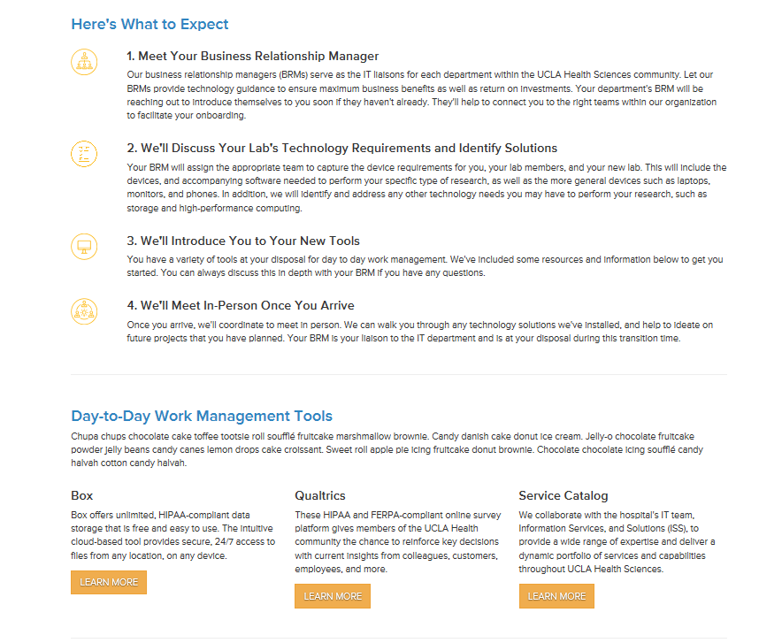
Faculty Onboarding
https://dgit.healthsciences.ucla.edu/pages/onboarding
Launched a faculty onboarding program and website.
Smooth transition as new faculty enter UCLA.
Initiate onboarding at time of offer prior to arrival at UCLA.
Meet all technology needs from device procurement to compute and storage.
Inform faculty of services available to them.
Create strong partnerships with faculty.

Slide 23
Faculty Engagements
67 Faculty Engaged
10 Faculty Onboarded
Note: multiple interactions typically take place with each faculty. The data shows # of unique faculty in one quarter, not # of interactions

Slide 24
Research Engagements by Service
Meeting with faculty to address and discuss any service area questions/concerns.
Refining/ augmenting our services to meet their needs

Slide 25
DGIT Data Center Services
Compute & Hosting
Enterprise Storage
Backup & Replication
Scalable, resilient, monitored, server environment
Database/Application hosting
Fast, secure file sharing
Tiered data and archive options
Collaboration platform available
Daily snapshots
Flexible data retention
Disaster recovery platform

Slide 26
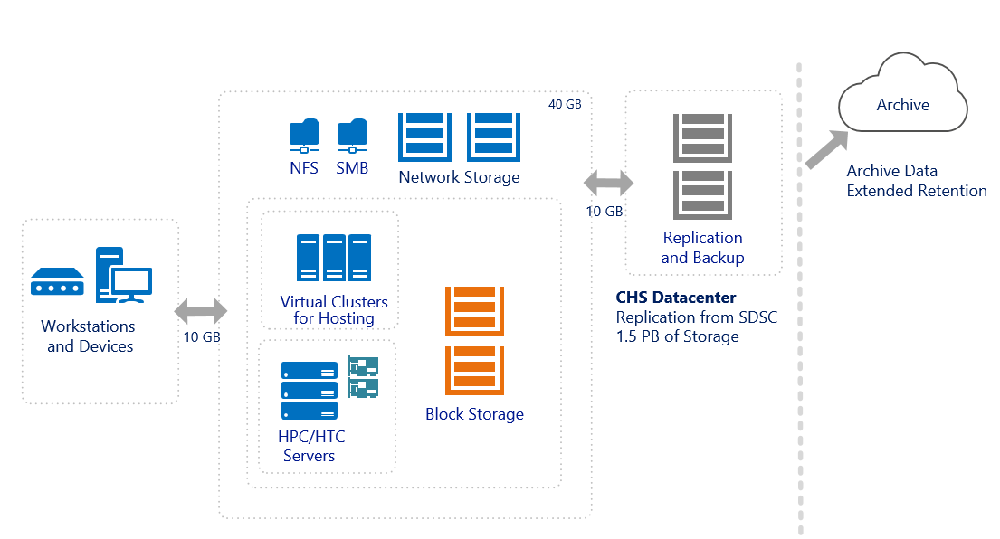
DGIT Data Center Topology- San Diego Super Compute
DGIT Datacenter at SDSC
Storage: 1.3 PB NetApp, 65 TB Pure
Compute for Hosting: 36 Hosts, 1008 Cores, 18,432 GB RAM
Compute for High Throughput Workloads: 4 Hosts, 512 Cores, 4096 GB RAM, Tesla GPU options

Slide 27
Cloud Services
DGIT AWS
DGIT administers a HIPAA-compliant AWS instance enabling clients to consume cloud resources in a safe, secure environment
Capabilities
Compute: Virtual machines ranging from small to extremely powerful
Storage: Effectively infinite tiered options
Data Management: Databases and related structure
Services: Special features such as streaming data analytics
Benefits/Value
Platform can scale up or down to meet current demand
Ability to implement processing pipelines, build and test modifications, create websites and web apps
Securely manage your research computing environment
Archive data inexpensively with extremely high reliability

Slide 28
Storage Options
HDD – Standard hard drives for general data and backup systems
SSD – Flash storage for virtual machines and database workloads
AWS – Scalable platform for any data type, including archive
DGIT Storage

Slide 29
Compute for Researchers HTC & GPU Compute Services (Coming Soon)
Design
Cisco hardware featuring high core, high memory blades
Dedicated physical systems to accommodate GPU
DGIT managed/hosted service
New less-restrictive Research security zone in the DGIT datacenter
Benefits
Leverage existing compute, storage and network infrastructure
Eliminate “Under desk” GPU desktops in labs
Fast, easy GPU provisioning and potential for vGPU sharing
Status
Working with Cisco, NVidia and VMware on architecture

Slide 30
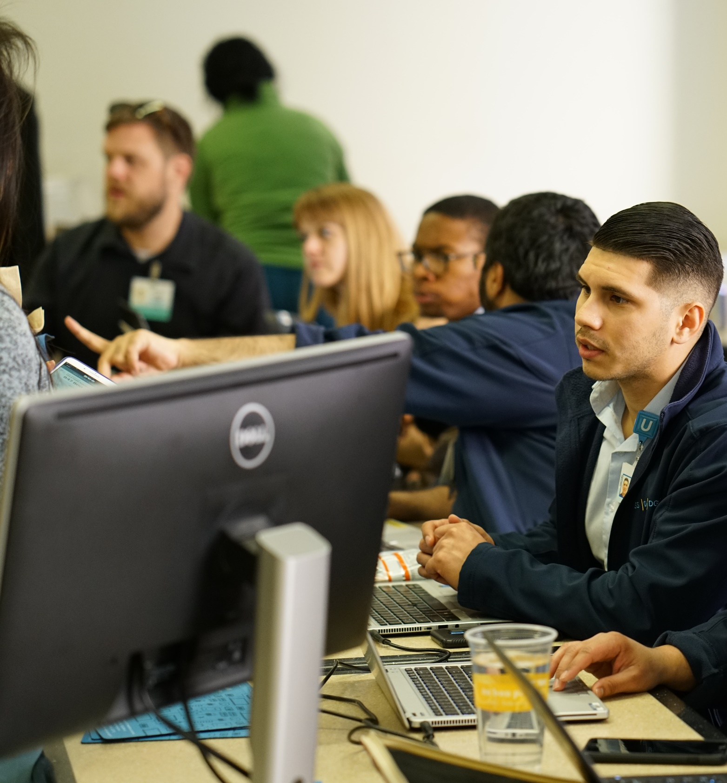
Training

Slide 31
Major focus of training
Cloud File Storage
Summary
An intuitive cloud-based tool that provides secure, 24/7 access to files from any location, on any device.
Key Stat
Online Surveys
Summary
An easy-to-use tool to make surveys, process data, and create reports that help you share your findings.
Key Stat
Video Conferencing
Summary
Schedule and host online meetings that are secure and can be joined via most devices and browsers.
Key Stat
Security and support
Encryption
Duo
Technology Events
4
# of events held
395
# of attendees
39
168
TB
102K
Responses
4,500
Meetings
# of faculty participants
6
Amount of data stored in Box
Number of survey responses sent
Number of meetings held in a month
# of topics

Slide 32
Lessons Learned
Establish Faculty champions
Communicate often with use cases on service offerings
Move from IT as a service to IT as a partner
Move from ticket centric IT to holistic customer centric IT
Establish Research IT governance with the business leading and prioritizing to organization’s strategic plan

Slide 33
Challenges
Lack of robust funding from researchers towards IT initiatives- Need for subsidies centrally
Expanding storage needs by researchers
Gaining respect and trust of researchers towards IT is a slow and labor intensive process
Preference from some researchers towards decentralized local support over enterprise IT, despite enhanced spectrum of service offerings, robust infrastructure and security
Striving to meet the needs of the individual researchers while remaining strategic in selecting initiatives that benefit the larger organization

Slide 34
DGIT Team Acknowledgements
Cliff Kravit
Program Manager
Research Enablement
Ismail Mitchell
Program Manager
Research Enablement
Mayra Solano
Web Product Manager
Kristen Lineberger
Content Strategist + Web Product Manager
Arun Budhwani
Sr. Dir. Service Delivery
Mike Shane
Dir. Infrastructure

