Slide 1
A Strategic Approach to IT Savings at UCLA Health
Michael Pfeffer, MD, CIO, UCLA Health
Hal Bookbinder, Dir, IT Strategic Finance

Slide 2
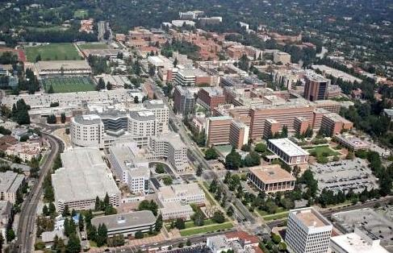
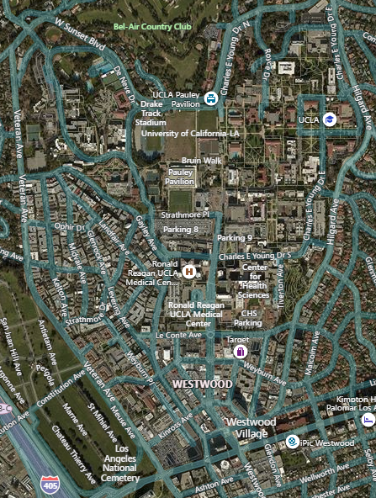
UCLA Health IT
$4.1B, 4 hospitals, >170 clinic locations, 24,124 FTE.
IT: $200M Capital & Expense, 691 FTE.
Ronald Reagan UCLA Medical Center
David Geffen School of Medicine at UCLA
Resnick Neuropsychiatric Hospital at UCLA
UCLA Mattel Children's Hospital
UCLA Medical
Center Santa Monica
UCLA Medical Plaza

Slide 3
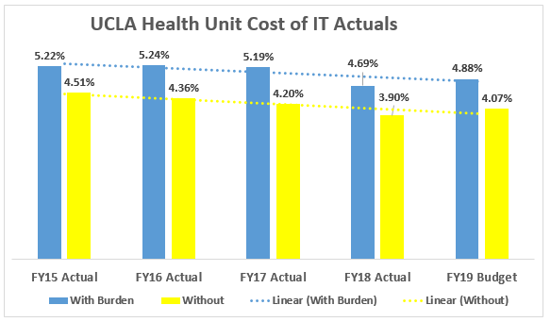
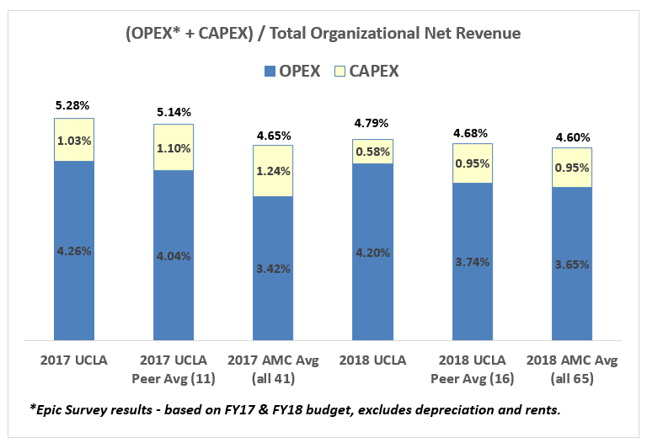
Challenge #1
Run IT like a business
Deliver meaningful non-staff savings with no negative impact on product or service delivery.
Focus on the “value of IT” while managing to a stable or reduced “unit cost of IT”.

Slide 4
FY19 Prelim.

Slide 6
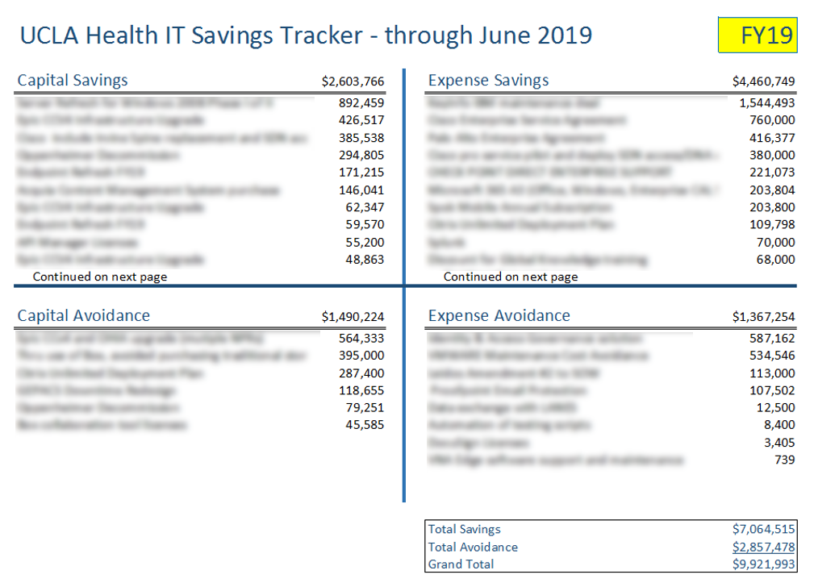
Challenge #2
IT leaders must deliver both technology and business excellence.

Slide 8
Traditional Approach
Rely on core financial team to drive savings
Generate savings through tight control/review.
Core team provides tools, training and disciplines.
Acquisitions
Financial Evaluations
Negotiation
Renewals
Finance / Vendor Mgmt Team
Vendor Analysis
RFP / RFI

Slide 9
Problems with this approach
Limited expertise.
Ownership.
Bottlenecks.
Lead time.

Slide 10
Strategic approach
Cost management in IT Strategic Plan.
Line management ownership.
Train management in negotiation.
Track, encourage & recognize.
Finance team as expert advisors.

Slide 11
IT Strategic Plan 2017-2022
Objectives
Provide world class services & systems.
Ensure resiliency of IT infrastructure.
Be the best health IT department to work for.
Innovative delivery of care.
Innovative delivery of education and research.
Decrease unit cost of IT.
+ Goals, Strategies and Metrics for each

Slide 12
Setting Expectations and Providing Training

Slide 13
Enhancing Negotiation Skills
Reference material/tools
Vendor year-end schedules.
Negotiation checklist.
Excel financial tools to assess & compare offers.
Required vendor offer format.
Major negotiation timeline & responsibilities. *
Manager/director full-day offsite
Half-day spent refreshing the strategic plan.
Half-day spent in negotiations workshop.
* Under development

Slide 14
Tracking and Reporting Phase I
Created IT Savings Tracker.
Directors or designees update it.
IT leaders discuss results monthly.
Shared quarterly with full IT staff.
Terms defined, rules in place.
Standardized capture & display.
Responsibilities made clear.
Visibility.

Slide 15
Tracking and Reporting Phase II
Included all large spends in IT Savings Tracker.
Directors enter related savings or no savings.
Can also enter savings not related to spends.
Immediate graphical updates included.
Increased consciousness of spend & savings.
Subtle encouragement to deliver savings.
More likely savings would not be overlooked.
Ability to clearly tie back savings to budget/plan.

Slide 16
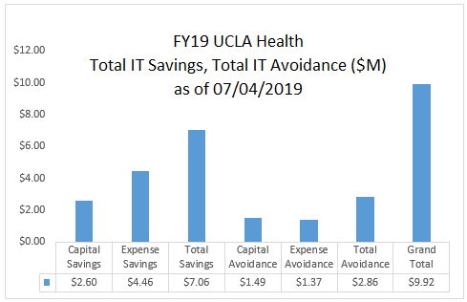
IT Savings Tracker Process
IT Capital Tracker
Review & Update
Action List
Action List
IT Savings Tracker
IT Directors
Scripted Update
Quality Review
IT Expense Tracker
Pulls all new spend > $50K
Freezes entries since last update
Clears the input form
IT Finance

Slide 17
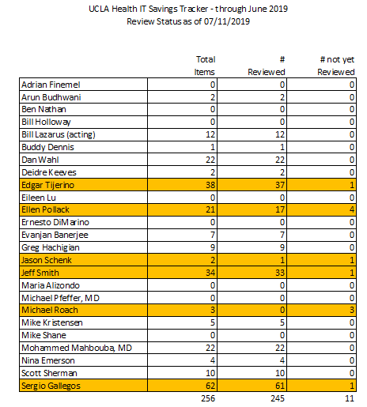
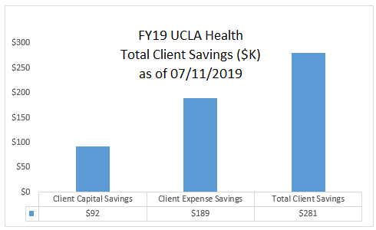
Visualizations

Slide 18
Guidelines
“Savings” indicates item was budgeted.
“Avoidance” indicates it was unplanned.
Savings must be result from our actions.
Only count savings beyond normal discounts.
Savings are amortized over service period.
User and IT savings are tracked separately.
All savings are categorized by method.

Slide 19
Results
$25 million
in savings &
avoidance
over 3 years!

Slide 20
A Strategic Approach to IT Savings:
Technology Leaders as Business Leaders
Questions?

Slide 21
Optional slide if asked how savings calculated.

Slide 22
Savings Calculation Example
$1M FY20 budget for XYZ software. Have been renewing annually.
Rack price turns out to be $1.2M, or $960K with standard 20% educational discount.
3-year renewal for $2.088M ($696K/year, 42% discount). Includes $100K “free” consulting/year (not budgeted).
Savings calculation:
Spend with 20% educational discount $960K
Actual spend with 42% discount $696K
Expense Savings $264K
Expense Avoidance $100K
Total Expense Savings & Avoidance $364K
Record additional savings, not cash flow, not budget.

